Slide 1
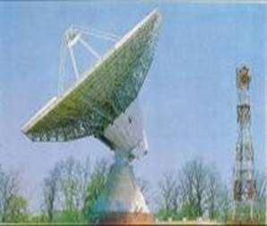
FM- TRANSMITTERS AND RECEIVERS

Slide 2
INTRODUCTION
The FM transmitters and receivers are those devices which is used for sending and receiving FM signal.
The transmitters are those devices which is used to send frequency modulated wave through a band and
the receivers are the devices which received modulated signal then after demodulation it gives us the original signal.

Slide 3
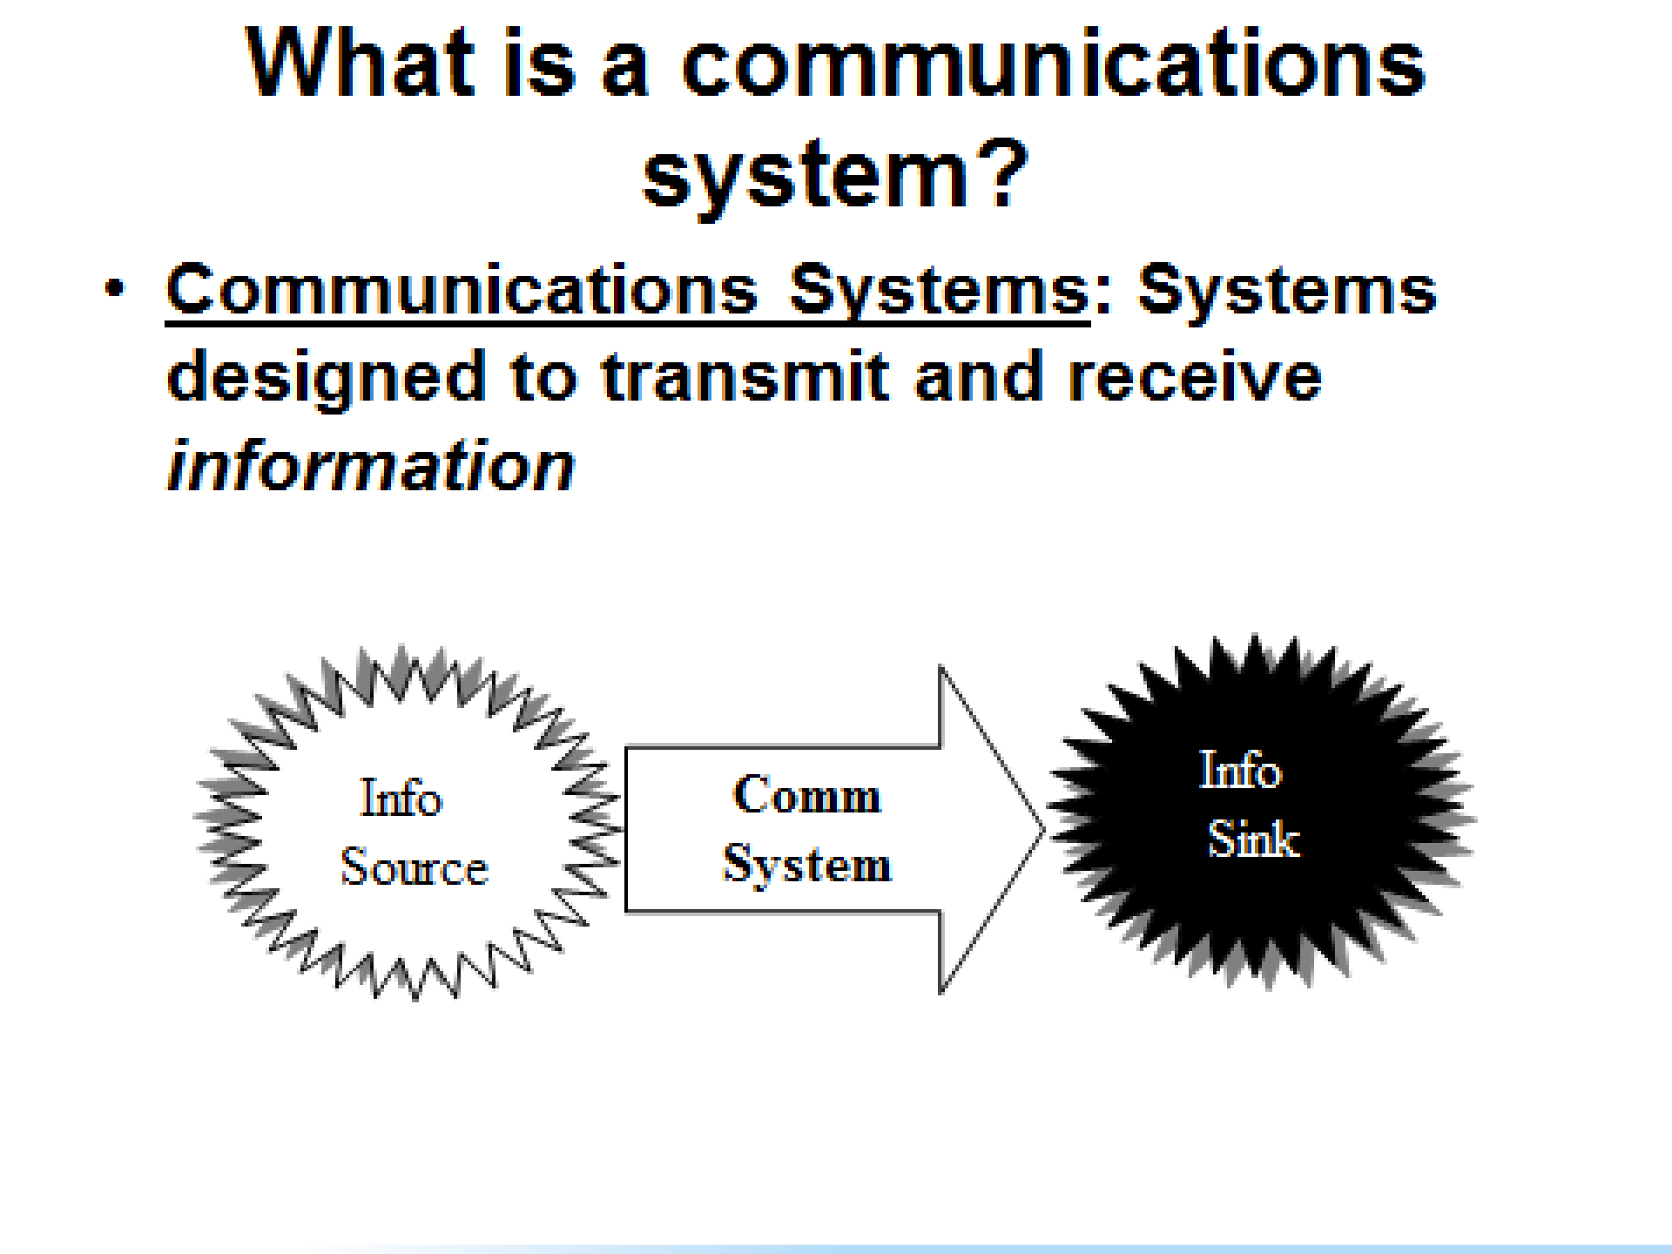
Destination

Slide 4



A
B
Engineering System
Social System
Genetic System
History and fact of communication

Slide 5
Block diagram of communication system
Information source
Speech picture/data
Input
transducer
transmitter
channel
receiver
Information in Electrical form
noise
Output transducer
Information in original form

Slide 6



“IT IS A PHENOMENON IN WHICH THE CARRIER SIGNAL IS VARIED IN ACCORDANCE WITH THE MESSAGE SIGNAL”
TYPES OF MODULATION
1. CONTINUOUS WAVE
When the carrier signal is continuous in nature,the
modulation process is
Known as continuous wave modulation.

Slide 7
Pulse modulation
When the carrier wave is pulse type waveform, the modulation process
Is known as pulse modulation.
Continuous wave modulation
Amplitude modulation
Angle modulation
Phase modulation
Frequency modulation

Slide 8
Unmodulated carrier, full power at all times
Waveform of modulating signal
Modulated carrier with frequency deviation and constant amplitude

Slide 9
DIFFERENT TYPES OF FM.
NARROW BAND F.M.
We know that the bandwidth of an FM signal depends upon the frequency Deviation (∆𝜔 = 𝑘_{𝑓}. 𝑥(𝑡).if frequency deviation is low it means 𝑘_{𝑓} is low then bandwidth will be narrow then narrow band FM is formed.
WIDEBAND FM
If frequency deviation (∆𝜔 = 𝑘_{𝑓}. 𝑥(𝑡) is high , it means frequency sensitivity 𝑘_{𝑓} is high result as bandwidth will be wide hence wide band is formed

Slide 10
METHODS OF FM GENERATION
DIRECT METHOD
INDIRECT METHOD
ARMSTRONG
METHOD
REACTANCE MODULATOR
VARACTOR
MODULATOR

Slide 11
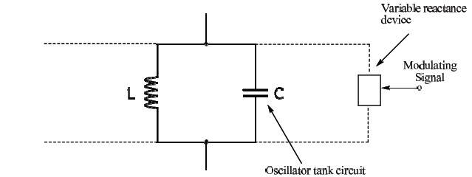
DIRECT METHOD-
In direct method, the modulating (base band) signal directly modulates the carrier .The carrier signal is generated using a LC oscillator circuit.
Frequency of oscillator of carrier
1
𝜔_{𝐶} =
𝐿𝐶

Slide 12
FM Transmitters
NBFM
WBFM
ANTENNA
Crystal
oscillator
phase modulator
frequency multiplier
Power amplifier
Audio source

Slide 13
Crystal oscillator-
Crystal oscillator generates the stable carrier signal.
phase modulator-
The phase modulator modulates the carrier signal and the massage signal in the low power range to generate a narrowband FM.
Frequency multiplier-
The frequency multiplier is used to increase the frequency deviation and carrier signal frequency to a desired level.

Slide 14
Power amplifier-
The power amplifier gives the required power level to the signal which passes through the antenna.
Antenna-
Antenna is a device which is used for sending and receiving the information.

Slide 15
FM Receiver
RF
tuned amp
IF
tuned amp
Discrimi- nator
De-
emphasis
mixer
limiter
AFC
Vol. & TONE
control
Delayed AGC
Local oscillator
Power
amp.

Slide 16
RF tuned amplifier-
These amplifiers are used for impedance matching to minimise noise level
Mixers-
These oscillator circuits are take any form to mix up the frequency modulated signal for performing the operation in such circuit central frequency are change but deviation are constant
Intermediate frequency amplifier-
The IF amplifier provides most of the gain and bandwidth requirement of the receiver.

Slide 17
Limiters-
Limiters are those circuit which allows the certain frequency
range to pass out and block the other signals
Discriminator-
The discriminator change FM into AM. A simple diode detection then recover the intelligence contained in the envelop of the AM waveform.
De-emphasis-
The artificial boosting given to the higher modulating frequencies in the process of pre-emphasis is nullified or compensated at the receiver by the process of De- emphasis

Slide 18
Vol & tone controller-
In this circuit it control the efficiency of audio signal. The signal whose efficiency is more then audible range are neglected in this circuit.
Power amplifier-
The power amplifier gives the required power level to the signal which passes through the loudspeaker.

Slide 19
PERFORMANCE COMPARISION B/W FM & AM SYSTEM
FM SYSTEM
AM SYSTEM
Amplitude is constant & independent of modulation index & hence the transmitted power remains constant
Amplitude will change with modulating voltage& transmitted power is dependent on the modulating index
Transmitted power is useful
Carrier power and one sideband power are useless
Immune to noise
Not Immune to noise
Bandwidth is large hence wide channel is
required 2(∆𝜔 + 𝑓_{𝑚})
Bandwidth is less then FM 2𝑓_{𝑚}
FM transmission & reception equipment
are more complex
AM transmission & reception equipment
are more complex

Slide 20
ADVANTAGES OF FM OVER AM
Noise reduction
Improved system fidelity
More efficient use of power
DISADVANTAGES OF FM OVER AM
Increased band width
Use of more complex circuit

Slide 21
APPLICATIONS-
Radio broadcasting
Two way mobile radio
Microwave communication
TV sound transmission
Cellular radio communication
Satellite communication

Slide 22
THANK YOU

